Slide 1
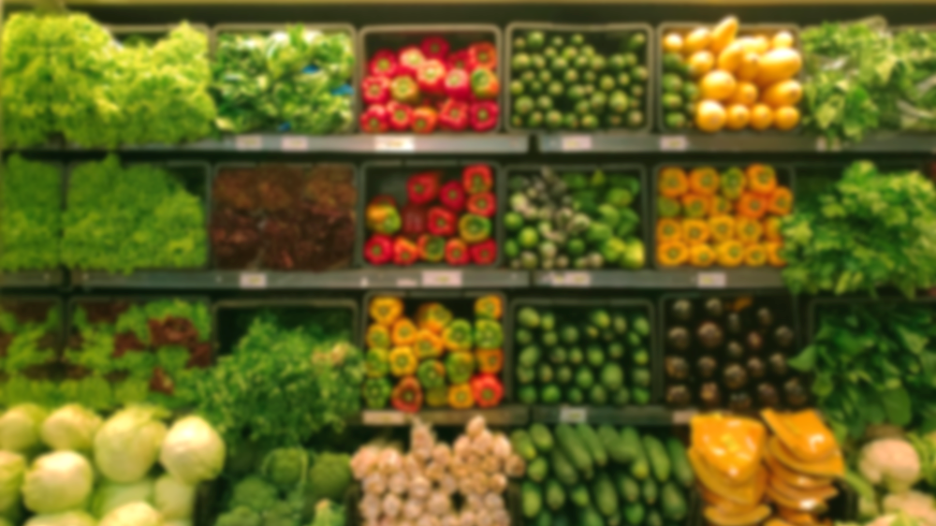
IOT APPLICATION FOR GROCERIES
TEAM 19 MINA JANG ANDREW BURCH JOSH WELSH

Slide 2
TABLE
CONCEPT
FUNCTIONAL REQUIREMENTS
NON-FUNCTIONAL REQUIREMENTS
USE CASES AND USE CASE DIAGRAM

Slide 3

CONCEPT
WHAT IS AN IOT?
KEVIN ASHTON 1999 "The IoT integrates the interconnectedness of human culture - our 'things' - with the interconnectedness of our digital information system - 'the internet.' That's the IoT,"
PHYSICAL DEVICES CONNECTED TO INTERNET EX) SMART LIGHTBULB
RFID CHIPS COST WILL FALL AS LITTLE AS 10 CENTS
Notes:
https://www.zdnet.com/article/what-is-the-internet-of-things-everything-you-need-to-know-about-the-iot-right-now/

Slide 4
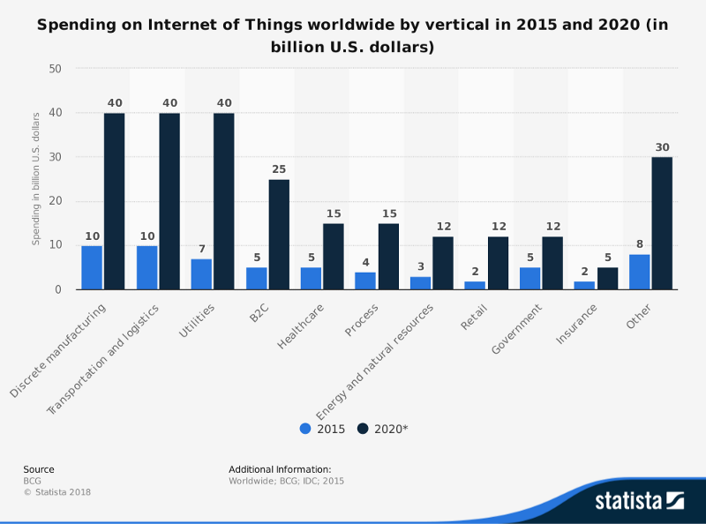
WHY IOT?
GRAPH COMPARES IOT SPENDING IN 2015 VS. 2020 FIELDS INCLUDE DISCRETE MANUFACTURING, TRNASPORATION AND LOGISTICS, UTILITIES, B2C…
MCKINSEY REPORTS EXPECTS IOT TO REACH AN ANNUAL ECONOMIC IMPACT OF $3.9 TRILLION TO $11.1 TRILLION BY 2025
RISE IN DEMANDS
Notes:
https://www.statista.com/statistics/666864/iot-spending-by-vertical-worldwide/
https://www.mckinsey.com/business-functions/mckinsey-digital/our-insights/the-internet-of-things-the-value-of-digitizing-the-physical-world

Slide 5
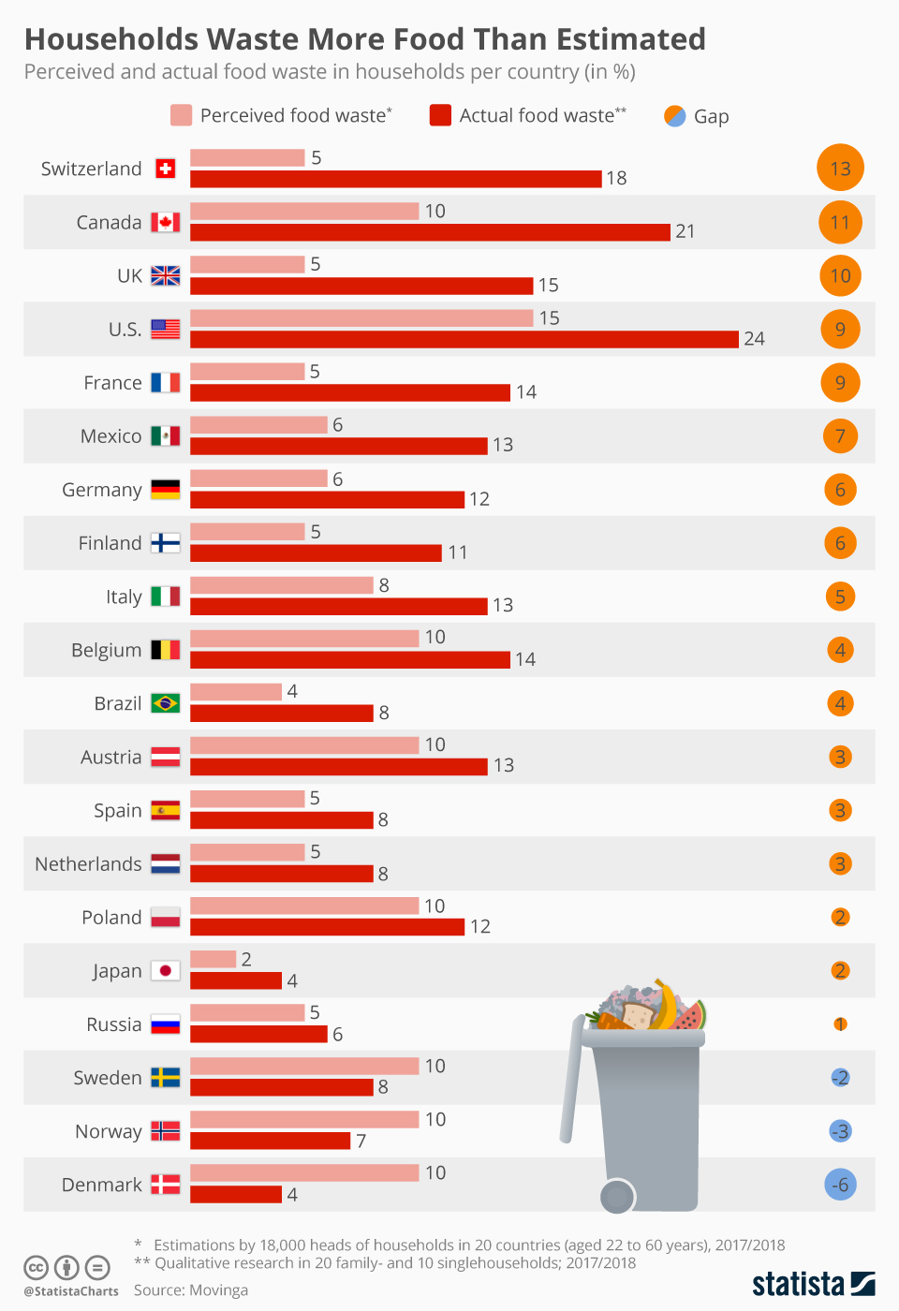
FOOD WASTE
MOVINGA STUDY ONE FOURTH OF THE FOOD PURCHASED BY US HOUSEHOLD GOES TO WASTE
ENVIRONMENTAL CAUSE 11 PERCENT OF GREENHOUSE GAS
ECONOMIC IMPACT 40% OF FOOD IS LOST OR WASTED COSTING $218 BILLION ANNUALLY
Notes:
https://www.statista.com/chart/15143/percieved-food-waste/
https://letstalkscience.ca/educational-resources/stem-in-context/environmental-impact-wasted-food
https://www.epa.gov/international-cooperation/international-efforts-wasted-food-recovery#:~:text=In%20the%20U.S.%2C%2040%25%20of,%24155%2D405%20billion%20economic%20opportunity.

Slide 6

IOT FOR GROCERIES
EXPENSIVE SMART REFRIGERATORS GENERALLY PRICEY COMPARED TO AN ORDINARY DEVICE
PROBLEM WITH THE EXISTING APPLICATIONS TEDIOUS TO INPUT EACH ITEM
FUNCTIONALITIES READ BARCODE FROM THE RECEIPT STORE GROCERY INFORMATION PROVIDE EXPIRATION DATES RECOMMEND RECIPES

Slide 7


FUNCTIONAL REQUIREMENTS
BARCODE COMPATIBILITY
The application must be able to read the barcode on the receipt so that the relevant information for grocery list can be extracted.
ADD GROCERY
The user should be able to add individual groceries.
Notes:
- Add grocery: for users to add individual item if they choose to

Slide 8


FUNCTIONAL REQUIREMENTS
VIEW/REMOVE/EDIT GROCERY The user should be able to view, remove or edit items on the grocery list.
RECIPE SEARCH The application must have a search function that makes use of stored food and drink items as well as user-set conditions.

Slide 9
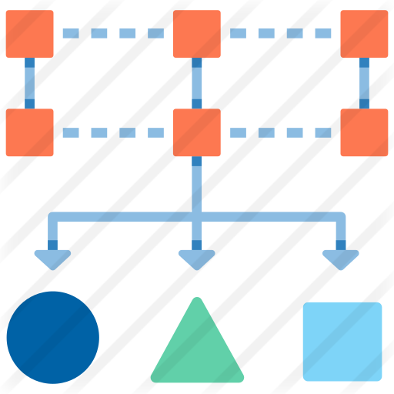

FUNCTIONAL REQUIREMENTS
GROCERY CLASSIFICATION The raw data is classified according to the grocery database provided by the server.
EXPIRATION NOTIFICATION
The application must notify the user of each item’s expiration date as it approaches.
Notes:
- Add grocery: for users to add individual item if they choose to

Slide 10


NON-FUNCTIONAL REQUIREMENTS
INTERNET CONNECTIVITY The application must have access to the Internet so that it may connect to the server database.
CONNECTION SPEED
The application’s Internet connection speed should be such that it generally returns search results within two seconds.

Slide 11


NON-FUNCTIONAL REQUIREMENTS
DATABASE UPDATE
If the grocery database does not have information on the new item, have the user input its food group and add it. Notify the server of the activity and update the database with the new information.
CONFIGURE NOTIFICATION
The user must have the ability to disable expiration and recommendation notifications or set their frequency.
Notes:
- Add grocery: for users to add individual item if they choose to

Slide 12
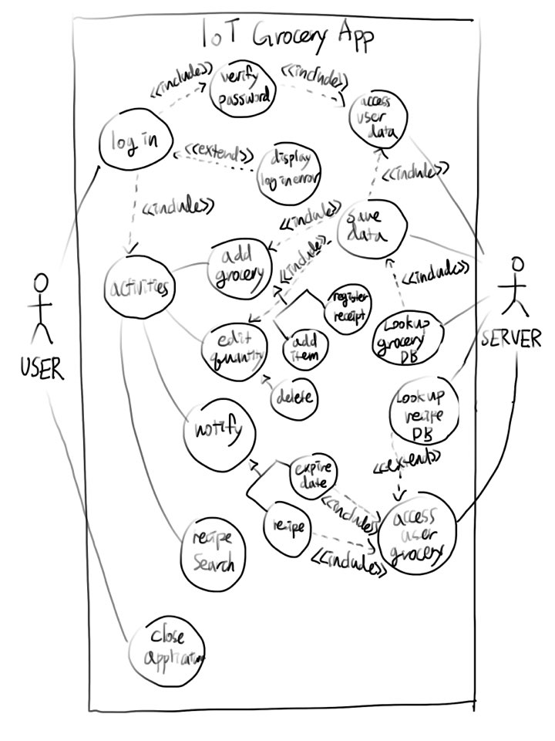
USE CASE DIAGRAM
Notes:
VERBAL DESCRIPTION OF HOW THESE RELATE TO REQUIREMENTS

Slide 13
THANK YOU FOR YOUR TIME
TEAM 19 MINA JANG ANDREW BURCH JOSH WELSH

